Slide 1
HTML & CSS Tiny Tips: making websites accessible
xbi 21 jan, 2025

Slide 2
Tiny Tips
HTML
Aria
CSS Basics & Overrides
WordPress & browser defaults
Making text easier to read
Making links easier to see
Helper classes

Slide 3
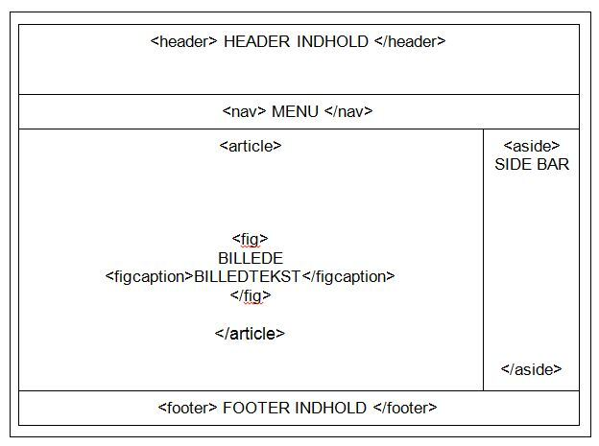
Accessible html:
Semantic HTML Elements
Use tags like <header>, <nav>, <main>, <ar­ ticle>, <section>, <aside>, and <footer> in stead of <div>

Slide 4
Enhancing Web Accessibility with ARIA
Making Web Applications Inclusive

Slide 5
Introduction to ARIA
ARIA stands for Accessible Rich Internet Applications.
It is a set of attributes that can be added to HTML elements to convey additional information to assistive technologies.
This additional information is invaluable for screen readers and other assistive technologies.

Slide 6
ARIA Roles for Document Structure
Roles define the purpose of an element.
ARIA roles provide context about an element's function.
ARIA roles are especially useful when dealing with non-standard or custom UI components.

Slide 7
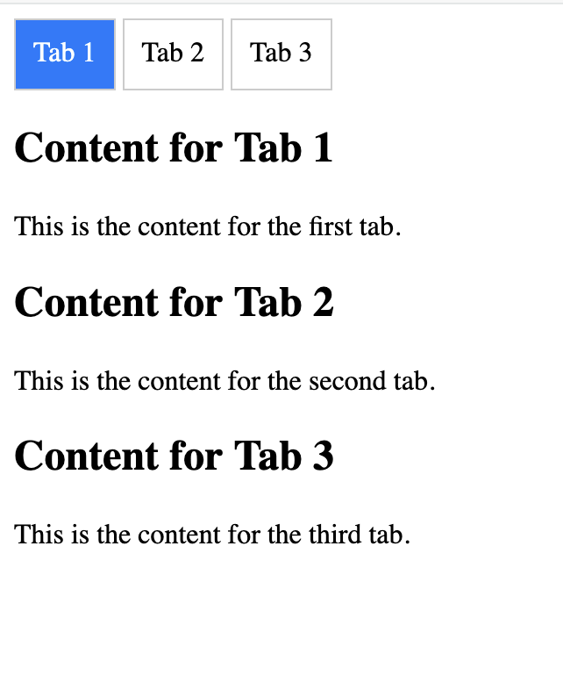
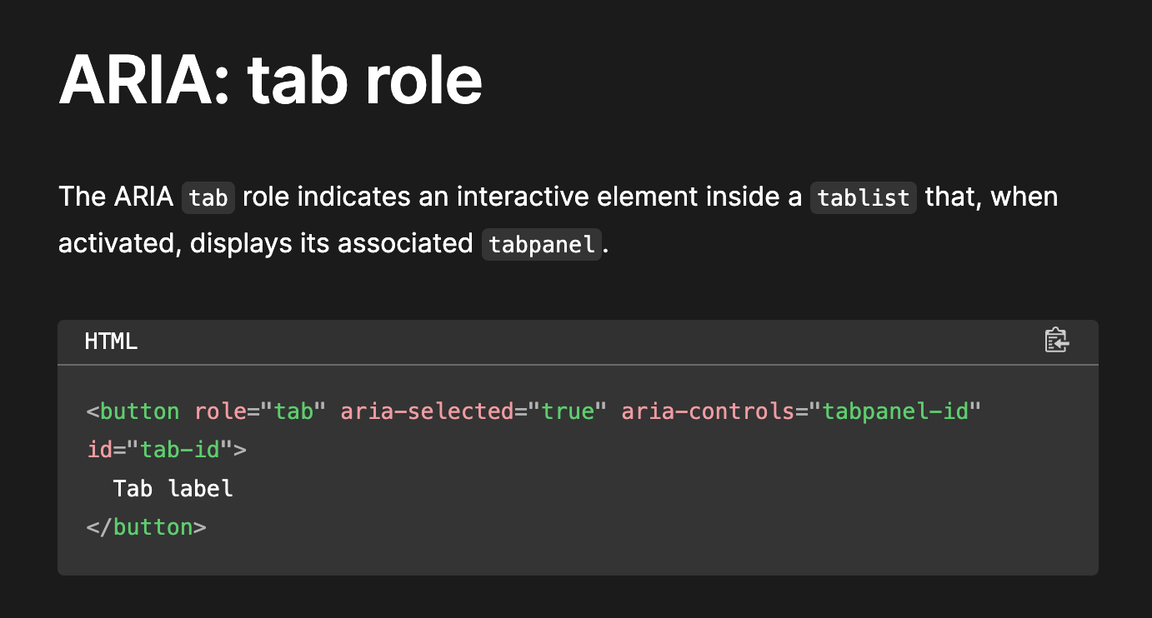

Slide 8
ARIA Attributes for Interactive Elements
ARIA attributes convey crucial information about an element's behavior, state, or properties.

Slide 9
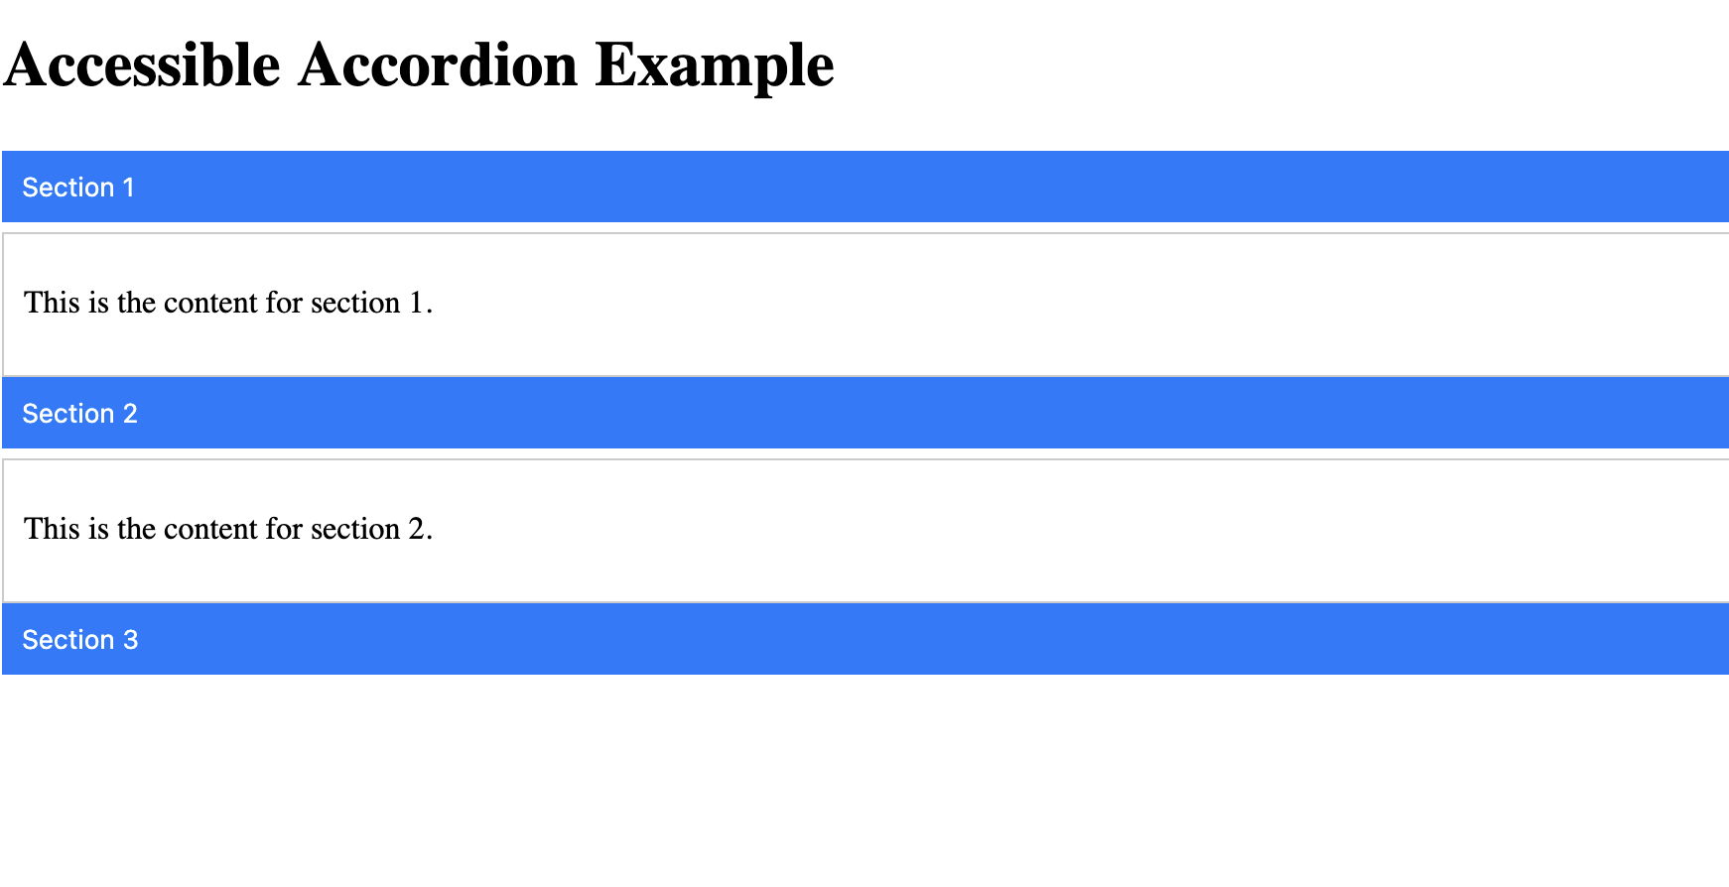
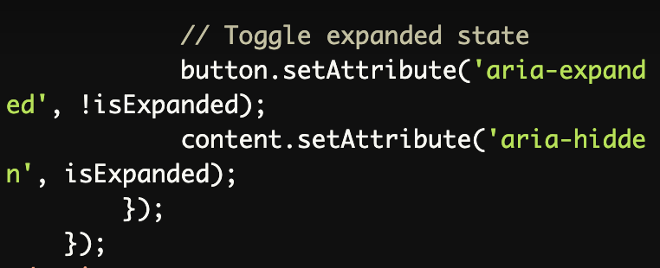

Slide 10
"no aria is better than bad aria"
Use ARIA roles only when necessary.
Use native HTML elements whenever possible.
Use ARIA attributes to supplement, not replace, native HTML semantics.
Notes:
https://www.a11ymatters.com/pattern/checkbox/ use h2 as label for the checkbox group

Slide 11
CSS Basics & Overrides

Slide 12
CSS belongs in stylesheet, not inline
Example of inline CSS: <span style=“color:blue”>Blue text</span>
Example of done in stylesheet: <span class=“blue-text”>Blue text</span>
The reason: A company changed their primary color. You can update a line of CSS or hundreds of inline styles.
Name it based on what people can remember. “Primary-color” for devs, “blue-text” for clients.

Slide 13
CSS variables are your friends
Variables allow you to update once, not a long search & replace.
:root { --link-color: #0000ff; /* blue */ }
.blue-text { color: var(--link-color); }

Slide 14
CSS color spaces: absolute values
#0000ff; // hex
rgb(0,0,255); // Red, Green, Blue
hsl(240,100%,50%) // Hue, Saturation, Lightness
Avoid alpha/opacity changes.

Slide 15
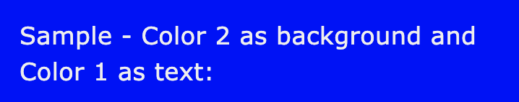
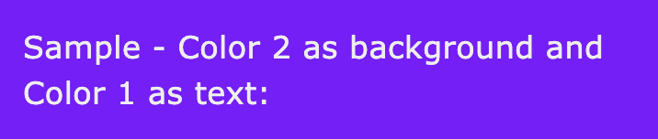
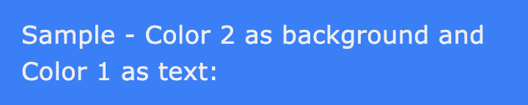
CSS color spaces: relative values
#0000ff; /* hex */
hsl(from #0000ff h s l); /* same blue color */
hsl(from #0000ff calc(h + 30) s l)
hsl(from #0000ff calc(h - 30) s l)

Slide 16
CSS :hover
https://codepen.io/CS80012/pen/PoKPKmW

Slide 17
CSS !important
!important is the override of last resort.
body .wp-block-button__link, body .wp-block-button__link:visited { color: blue !important; }
Don’t use unless you need to.

Slide 18
Semantic HTML is less CSS work
Semantic HTML is easier to write CSS for since elements already have a number of properties set & handled by the browser.
<div>s are not <button>s.
<div>s are not <fieldset>s either.
<div> is the most generic HTML element, while very useful, make sure something else isn’t more appropriate.

Slide 19
Semantic HTML is good SEO

Slide 20
Keep items in their containers
Make sure embeds and iframes fit their containers.
embed, iframe, object { max-width: 100%; }

Slide 21
Making text easier to read

Slide 22
Setting your fonts
Respect the user’s font preferences. Use rems, not pixels.
html { font-size: 100%; }
body { font-size: 1rem; }

Slide 23
Setting your line-height
Set reasonable relative line height. Do not use pixels.
body, button, input, select, textarea { line-height: 1.5; }

Slide 24
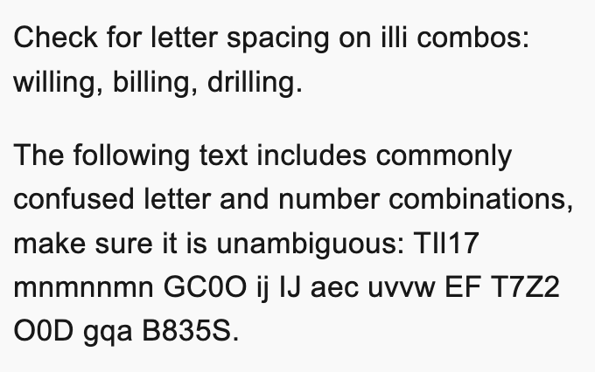
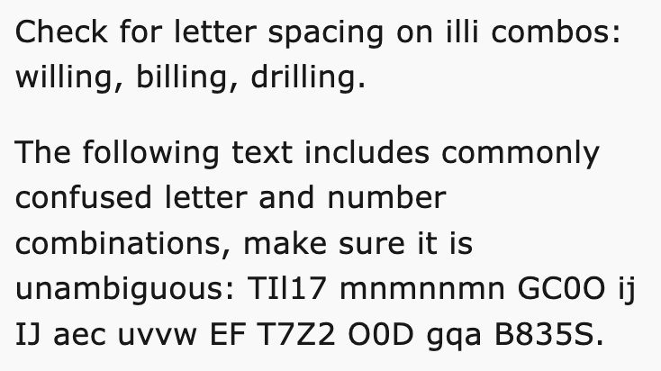
Slightly wider body fonts
Arial vs Verdana

Slide 25
Fallback fonts
Set fallback fonts to include web safe fonts & either serif or sans-serif.
Someday you will have a loading error on your fonts, this falls back gracefully.
body { font-family: Lato, Verdana, sans-serif; }

Slide 26
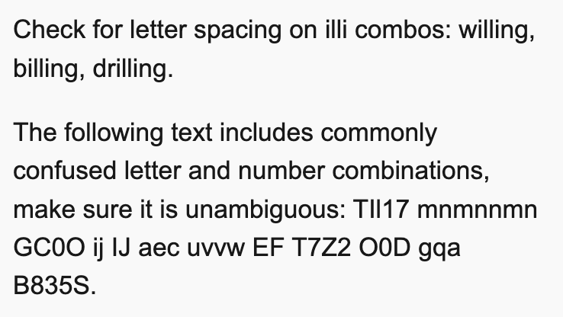
Letter spacing is your friend
Letter-spacing: 0.015em; /* or 0.2px; */

Slide 27
Making links easier to see

Slide 28
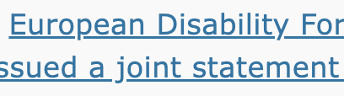
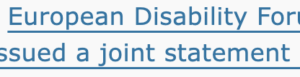
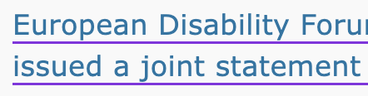
Add underline offset
Push the underline down so it doesn’t get broken.
Optionally, add a different color to it.
a {
text-underline-offset: 4px; text-decoration-color: blueviolet;
}

Slide 29
Checkboxes & Radios
Set the size of checkboxes & radios.
input[type=checkbox], input[type=radio] { min-width: 24px; min-height: 24px; width: 1.5rem; height: 1.5rem; }

Slide 30
Don’t forget :visited
a,
a:visited {
/* your styles */
}

Slide 31






Focus state: 2 colors
Use two colors to handle different background & foreground combos.

Slide 32


Focus state: dashed
Dashed border is visible regardless of background.
body a:focus, body a:visited:focus, body button:focus { outline: 2px solid var(--kaya-focus-color); border: 2px dashed white !important; }

Slide 33
Z index
Z index requires a position to be set.
position:relative; // most common.
.z0 {z-index: 0}
.z1 {z-index: 1}
.z10 {z-index: 10}

Slide 34
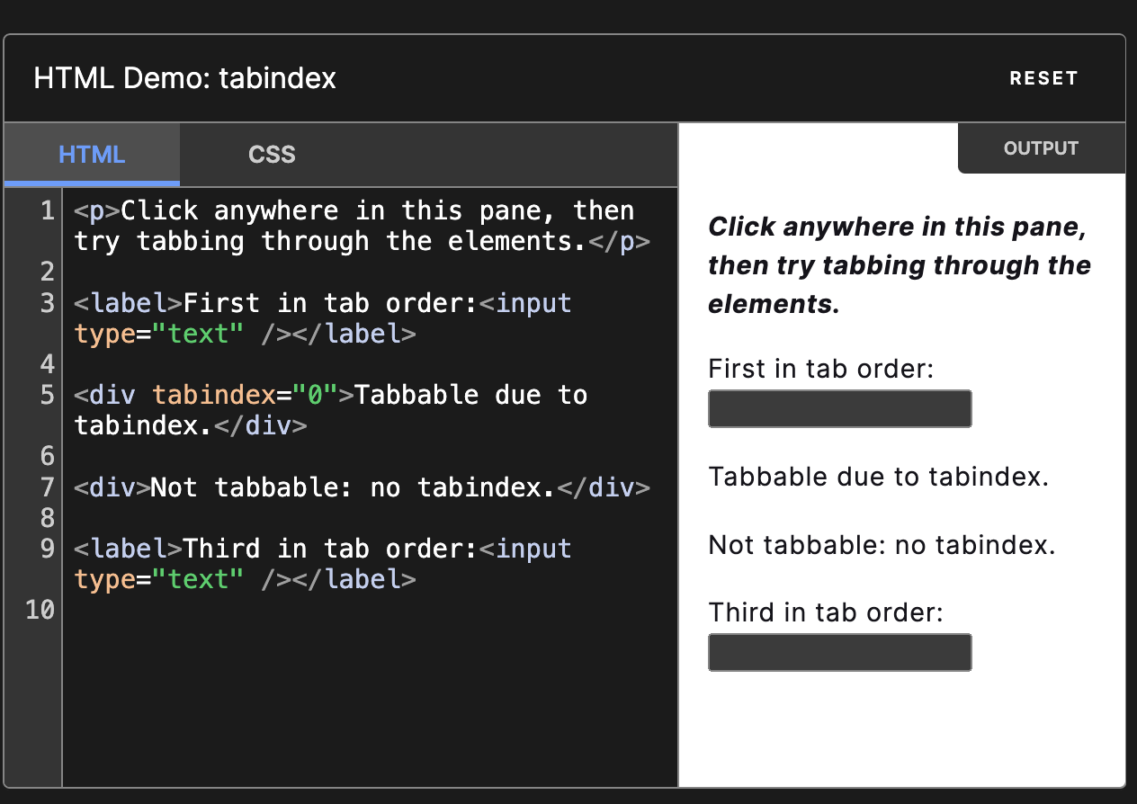
Keyboard tabindex=0
tabindex="0" attribute makes the link focusable using the “Tab” key and actionable using the “Enter” key.
tabindex - HTML: HyperText Markup Language | MDN (mozilla.org)

Slide 35
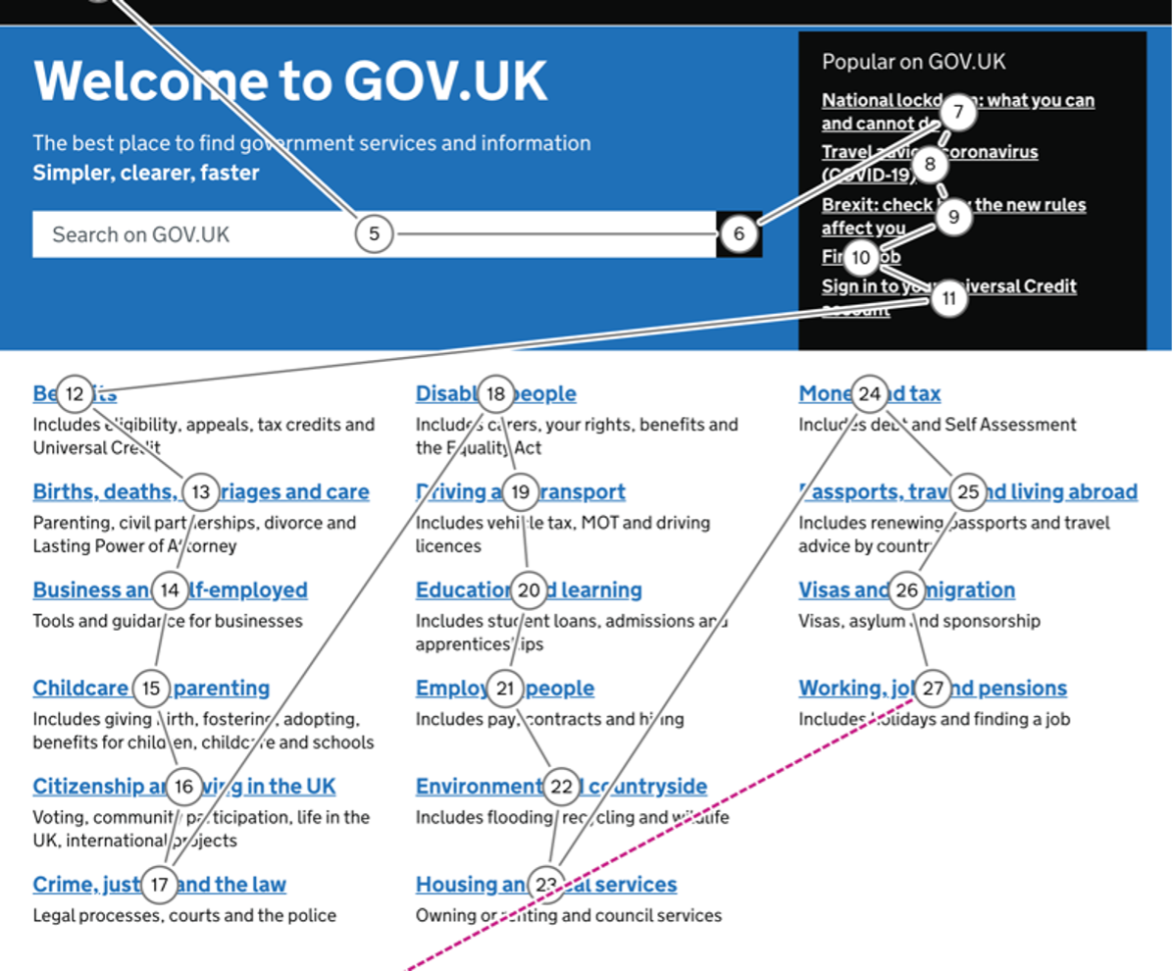
Notes:
https://design.homeoffice.gov.uk/accessibility/keyboard/focus

Slide 36
Source: Mastering HTML and CSS: Chapter 8: Web Accessibility. [Course document] https://www.a11yproject.com/checklist/

